Slide 1
Chapter 5 Containerization with Docker

Slide 2
Learning Topics
Overview of Docker
Docker Architecture
Container & Images
Docker Hub
Docker Best Practices

Slide 3
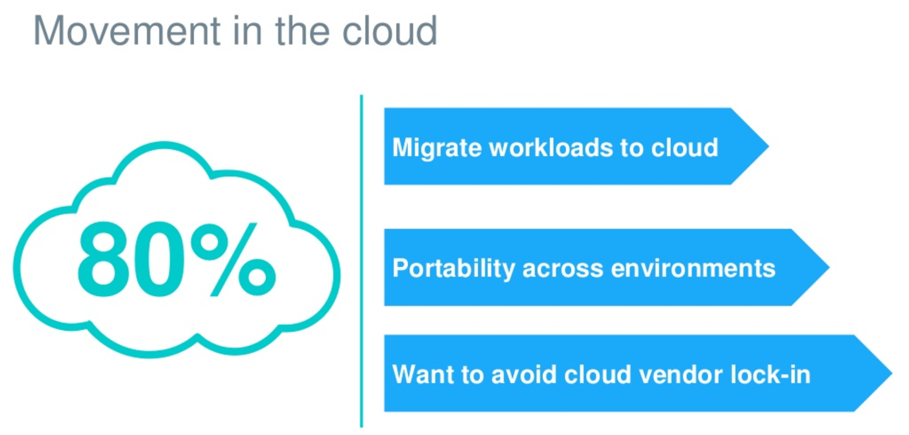
All Roads Lead to Cloud

Slide 4
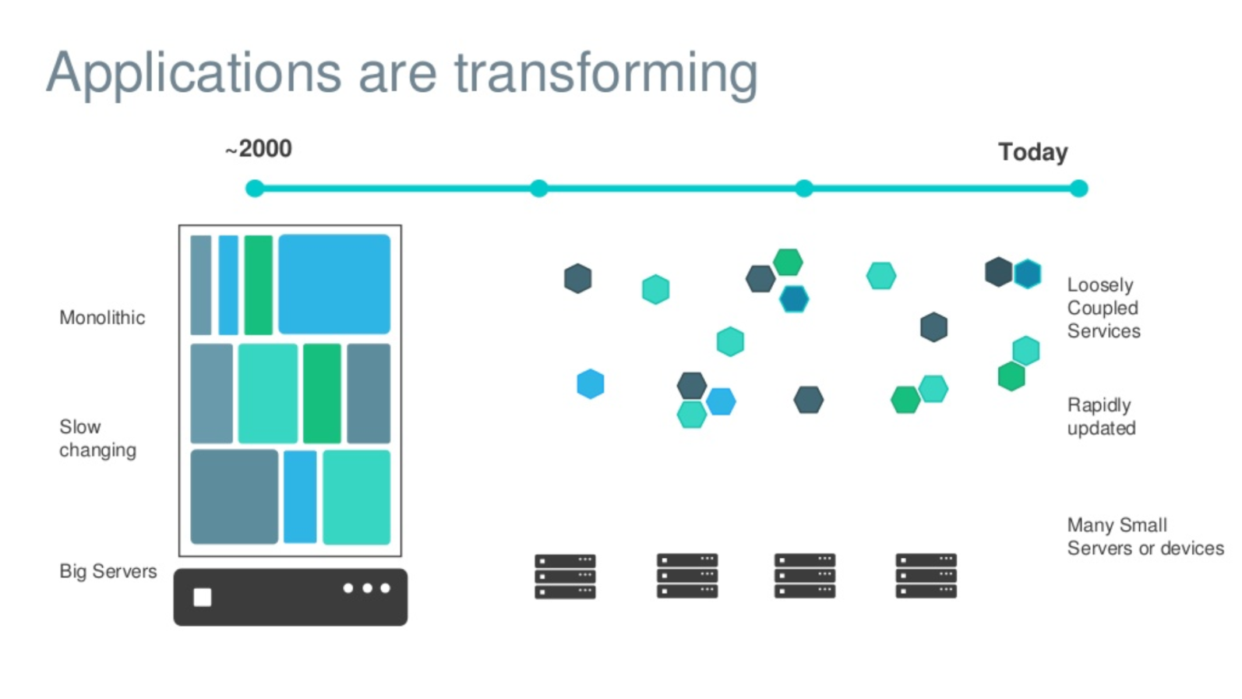
Evolving Workloads

Slide 5
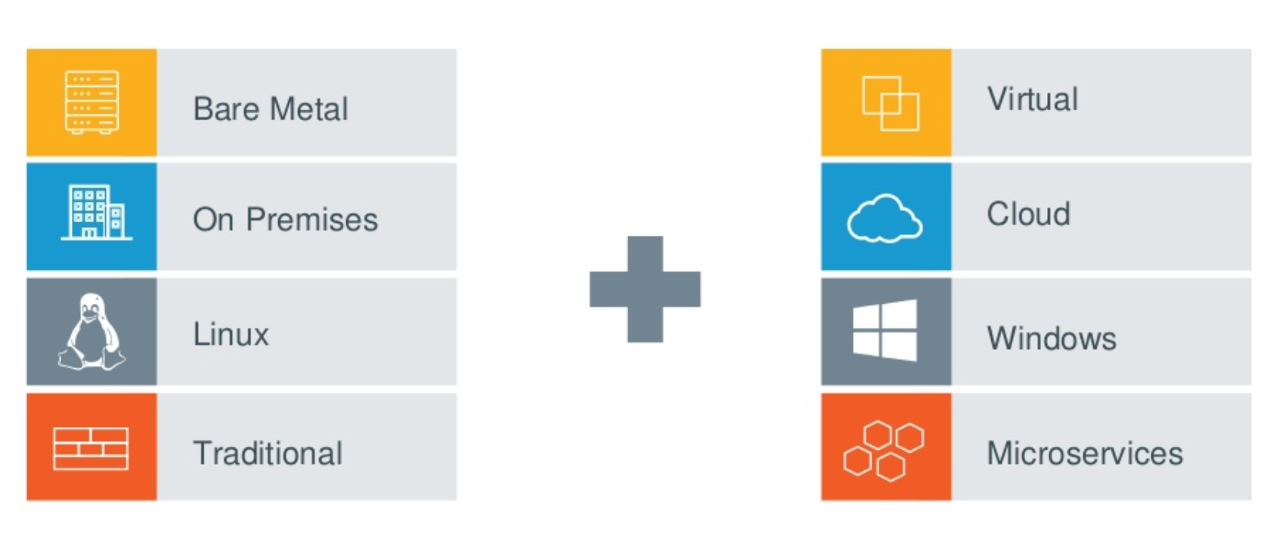
Multiple Requirements to Fill

Slide 6
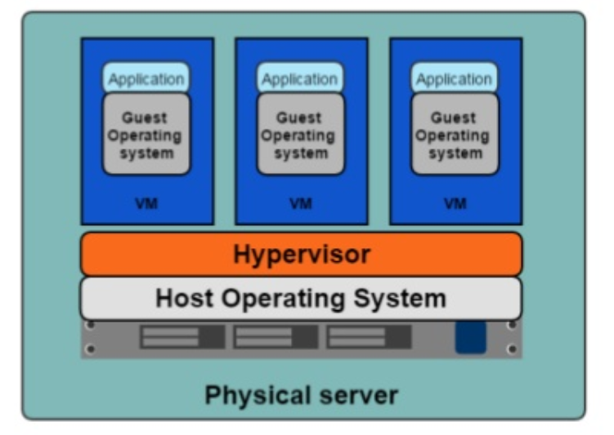
Hypervisor Based Deployments
One physical server can host multiple applications
Each application runs in a virtual machine (VM)

Slide 7
Virtual Machines – Pros & Cons
Each VM Requires its own resources
You need more resources to run more VMs
Application portability is not guaranteed
Easier to Scale
Better Resource Pooling
Supported by Cloud Platforms

Slide 8
Containers
An object for holding or transporting something
Standardized packaging for software and dependencies
Share same OS Kernel
Isolate apps from each other

Slide 9
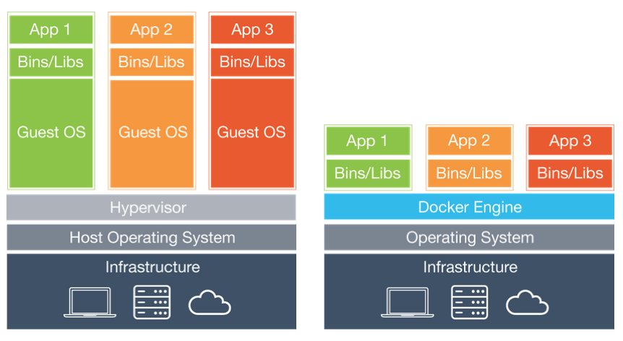
VMs Vs Containers
Infrastructure level construct
App level construct

Slide 10
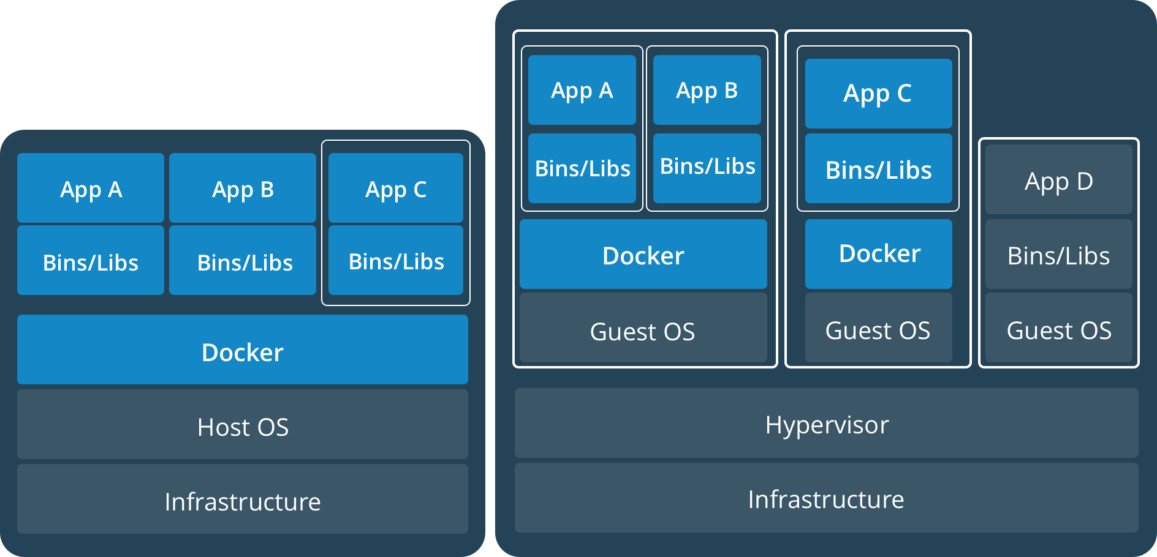
Containers AND VMs
Containers can run on standalone physical server and virtual machines
Provides tremendous flexibility for organizations
Deploy and manage apps

Slide 11
What is Docker?
Docker is an open platform for developers and sysadmins to build, ship, and run distributed applications, whether on laptops, data centre VMs, or the cloud.
Docker is a technology to package an application and all its dependencies into a single, easily transportable container
Fixes the traditional “But it works on my machine” problem

Slide 12
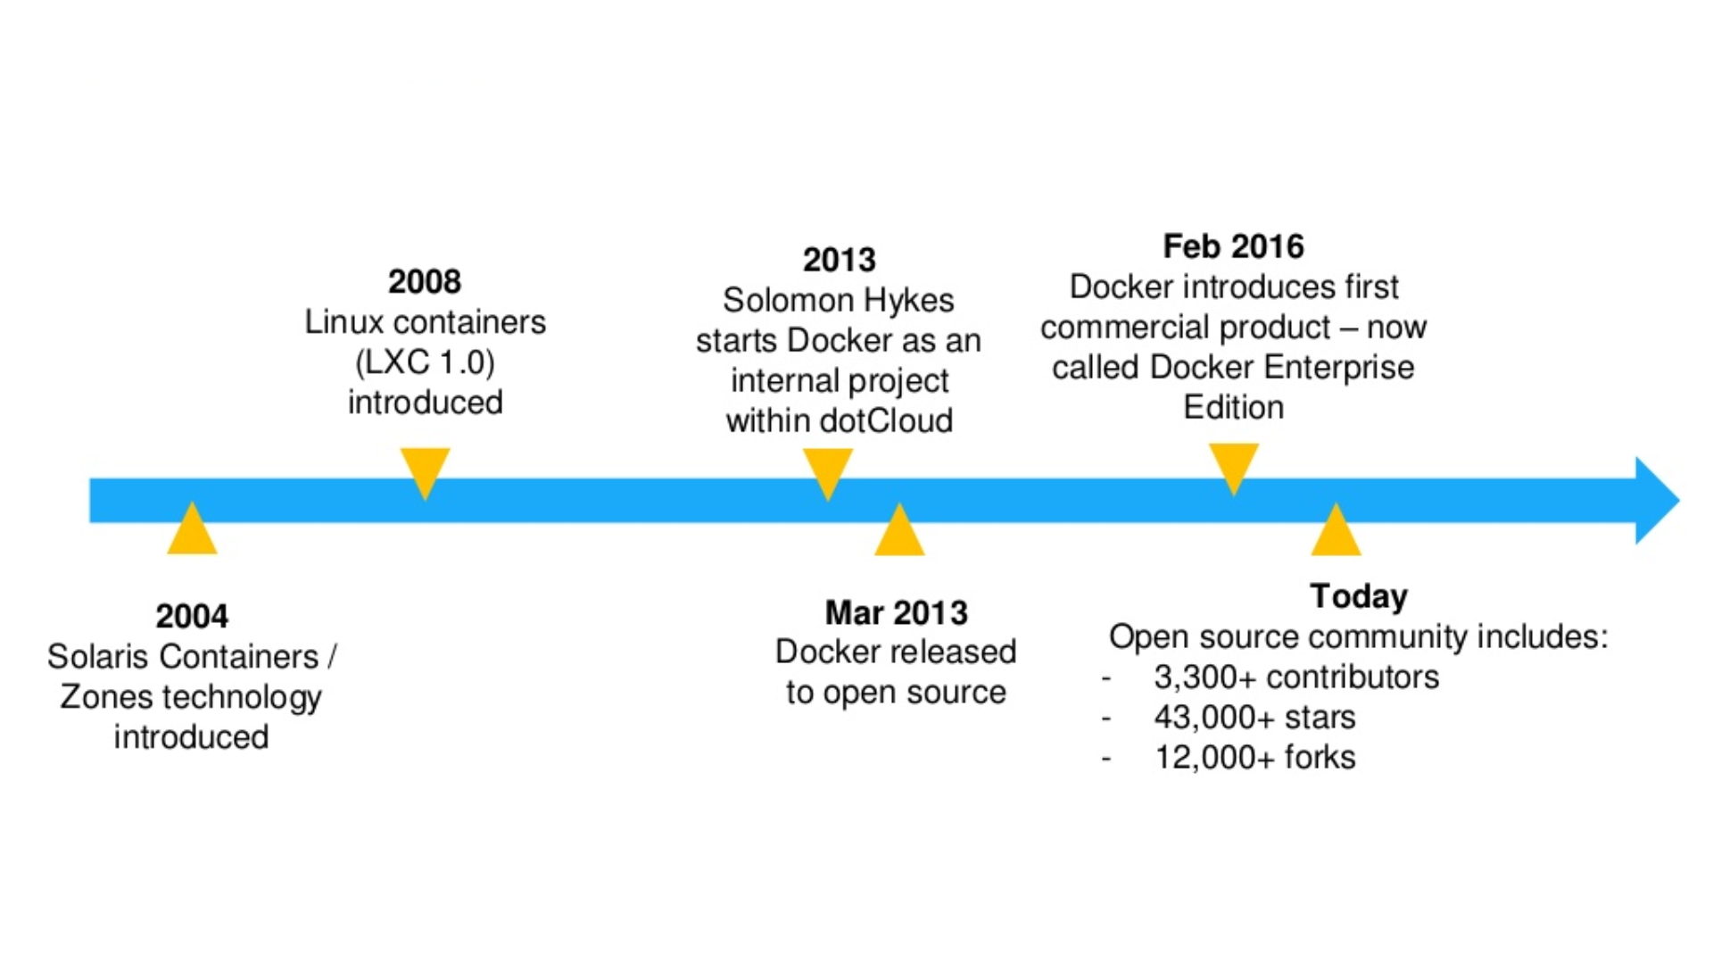
Docker History

Slide 13
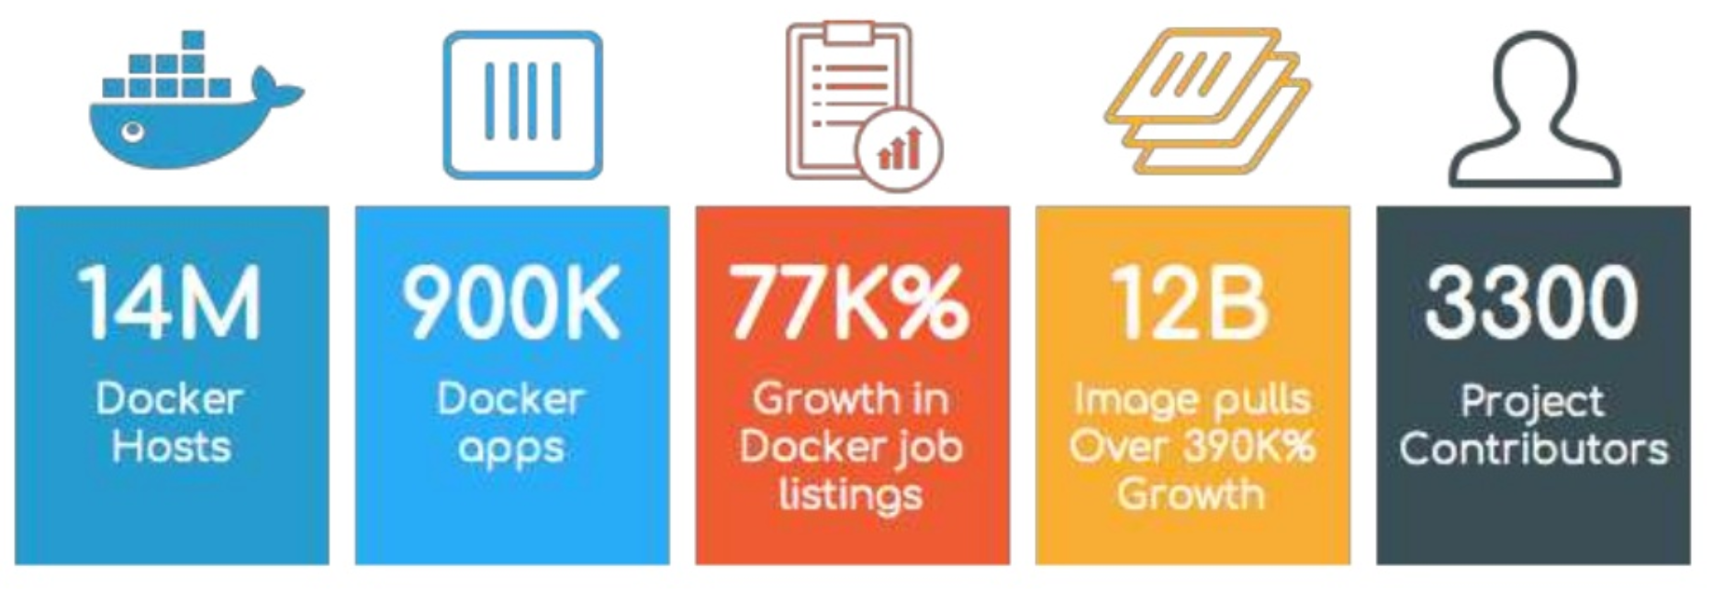
Docker Success Story

Slide 14
Advantages of Docker
Consistency
Write once, deploy anywhere
A complete platform
Manage entire lifecycle
Base engine for containers
Registry for image management
Compose for orchestration
Swarm for clustering
Machine for provisioning

Slide 15
Use Cases of Docker
Distributed Applications
Microservices
Continuous Integration
Continuous Deployment
Setting up Development Environment
Build, Ship and Run Any App, Anywhere

Slide 16
Docker – Lab 1
Run “Hello World” Docker Container

Slide 17
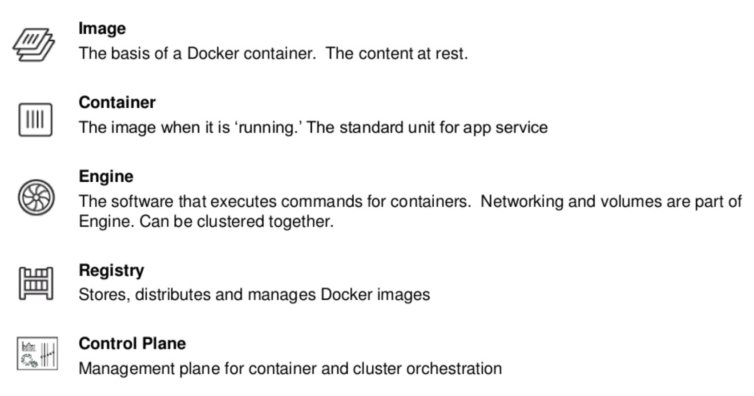
Docker Basics

Slide 18
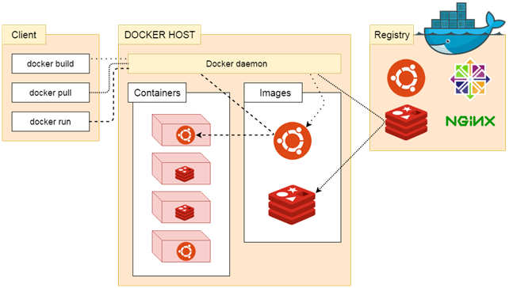
Docker Architecture
Docker uses a client-server architecture.
The Docker client talks to the Docker daemon, which does the heavy lifting of building, running, and distributing your Docker containers.
The Docker client and daemon can run on the same system, or you can connect a Docker client to a remote Docker daemon.
The Docker client and daemon communicate using a REST API, over UNIX sockets or a network interface.

Slide 19
Docker Daemon
The Docker daemon listens for Docker API requests
It manages Docker objects such as images, containers, networks, and volumes
A daemon can also communicate with other daemons to manage Docker services.

Slide 20
Docker Client
The Docker client is the primary way that many Docker users interact with Docker
When we use commands such as docker run, the client sends these commands to docker daemon, which carries them out
The docker command uses the Docker API
The Docker client can communicate with more than one daemon

Slide 21
Docker Registries
A Docker registry stores Docker images.
Docker Hub and Docker Cloud are public registries that anyone can use
Docker is configured to look for images on Docker Hub by default
You can configure your own private registry
When you use the docker pull or docker run commands, the required images are pulled from your configured registry
When you use the docker push command, your image is pushed to your configured registry

Slide 22
Images
In Docker, everything is based on Images
An image is a read-only template with instructions for creating a Docker container
Usually an image is based on another image, with some additional customization.
For example, you may build an image which is based on the ubuntu image, but installs the Apache web server and your application, as well as the configuration details needed to make your application run.

Slide 23
Lab 2 – Run Container From Image
Create couple of images
Ubuntu
Apache Server
Run all commands for images in your environment

Slide 24
Containers
The basic purpose of Docker is to run containers
A container is a runnable instance of an image
You can create, start, stop, move, or delete a container using the Docker API or CLI
When a container is removed, any changes to its state that are not stored in persistent storage disappear
A container is defined by its image as well as any configuration options you provide to it when you create or start it

Slide 25
Containers Cont.
Container can expose ports and volumes to interact with other containers or/and outer world
Containers are always created from images
Containers gives you instant application portability
All containers must use the same operating system
A container is defined by its image as well as any configuration options provided to it when it is created or started

Slide 26
Container Commands - Lifecycle
docker create creates a container but does not start it.
docker rename allows the container to be renamed.
docker run creates and starts a container in one operation.
docker rm deletes a container.

Slide 27
Container Commands – Start and Stop
docker start starts a container so it is running.
docker stop stops a running container.
docker restart stops and starts a container.
docker wait blocks until running container stops.
docker attach will connect to a running container.
docker exec -it containername /bin/bash to enter a running instance

Slide 28
Container Commands – Information
docker ps shows running containers.
docker ps -a shows running and stopped containers.
docker inspect looks at all the info on a container (including IP address).
docker port shows public facing port of container.
docker top shows running processes in container.
docker stats shows containers' resource usage statistics.
docker stats --all shows a running list of containers.
docker cp copies files or folders between a container and the local filesystem.

Slide 29
Lab 3 – Portainer
GUI for Docker
Runs on 1 Docker Container
Free and Open Source

Slide 30
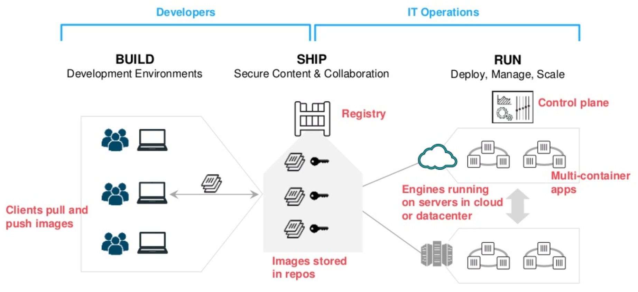
Containers as a Service

Slide 31
Dockerfile
A text document that contains all the commands, in order, a user could call on the command line to assemble an image
Build instructions to build the image
Usually dockerfile is called Dockerfile
Located in root of context
docker build -f /path/to/a/Dockerfile .

Slide 32
Dockerfile Instructions
A Dockerfile must start with a `FROM` instruction
The FROM instruction specifies the base image from which you are building
Docker treats lines that begin with # as a comment

Slide 33
Lab 4 – Dockerize .NET App

Slide 34
Lab 5 – Dockerize Java App

Slide 35
Lab 6 – Dockerize Python App

Slide 36
Docker Hub
Docker Hub is a cloud-based registry service
Docker users and partners create, test, store and distribute container images
Centralized resource for container image discovery, distribution and change management
User and team collaboration and workflow automation throughout the development pipeline.

Slide 37
Docker Hub - Features
Image Repositories - Lets you share images with co-workers, customers, or the Docker community at large
Organizations - Create work groups to manage access to image repositories
GitHub and Bitbucket Integration - Add the Hub and your Docker Images to your current workflows

Slide 38
Lab 7 – Push Images to Docker Hub
Create new repository in Docker Hub
Create an image
docker commit <existing-container> <hub-user>/<repo-name>[:<tag>]
Push an image in your repository
docker push <hub-user>/<repo-name>:<tag>
Pull image from your neighbour’s repository and run a container using this image

Slide 39
Docker Compose
Tool for defining and running multi-container Docker applications
Uses YAML file for configuration
3 Step Process
Create Dockerfile with Environment Information
Define Services for Your App in YAML file
Run Docker Compose

Slide 40
Lab 8 - Docker Compose
Create a Stack Using Docker Compose

Slide 41
Container Best Practices
Containers should be immutable
Containers should be ephemeral
Containers should be lightweight
One container, One responsibility, One process
Store share data in volumes, not in containers
Don’t store credentials in the image

Slide 42
Docker Development Best Practices
Keep your images small
Use tags to reference specific versions of your images
Store data using volumes

Slide 43
Docker Security Best Practices
Run Docker inside a virtual machine
Docker image ids are sensitive information. Should be treated as passwords, not exposed to outside world.
Set the container to be read-only
Set volumes to be read-only
Define and run user in your Dockerfile so you don’t run as root inside the container
Don't use an image unless it's official

Slide 44
This concludes Chapter 5 – Containerization with Docker Let us move to Chapter 6 – Container Orchestration with Kubernetes

